Slide 1
PSDS 4900 Capstone
Mapping Natural Disaster Locations From Social Media Content
11 August 2021
Jason Arbogast - AOTEM
arbogastjd@state.gov
Notes:
DO NOT PUT ANY INSTRUCTOR NOTES HERE. ALL INSTRUCTOR NOTES SHOULD BE IN THE LESSON PLAN.
NOTE: If your IP is UNCLASSIFIED, you do not need portion marks in the header.

Slide 2
Overview of Presentation
Define Problem and Motivation
Walkthrough of Web mapping application
Data flow into app
Classification using Recurrent Neural Network
Areas for further development

Slide 3
Problem and Motivation
Challenge:
Valuable locational information exists in unstructured text
Identify the most relevant posts or articles
Few posts are geotagged
User defined location not necessarily most relevant
Proposed Solution:
Leverage user created social media posts as a dynamic source of data to identify content based locations and classify relevance of posts

Slide 4
Shiny App Walkthrough
Shiny Web App to Explore Emerging Natural Disaster Locations:
Filter by Date and Time
Map clusters of location mentioned in relevant Tweets
Word cloud to orient to relevant topics
Filter data by Topic/Disaster Type
Drill to Country then State/Province Level
Data table to enable export to other applications
Notes:
DO NOT PUT ANY INSTRUCTOR NOTES HERE. ALL INSTRUCTOR NOTES SHOULD BE IN THE LESSON PLAN.

Slide 5

Shiny App Walkthrough - Intro Screen
Notes:
DO NOT PUT ANY INSTRUCTOR NOTES HERE. ALL INSTRUCTOR NOTES SHOULD BE IN THE LESSON PLAN.

Slide 6
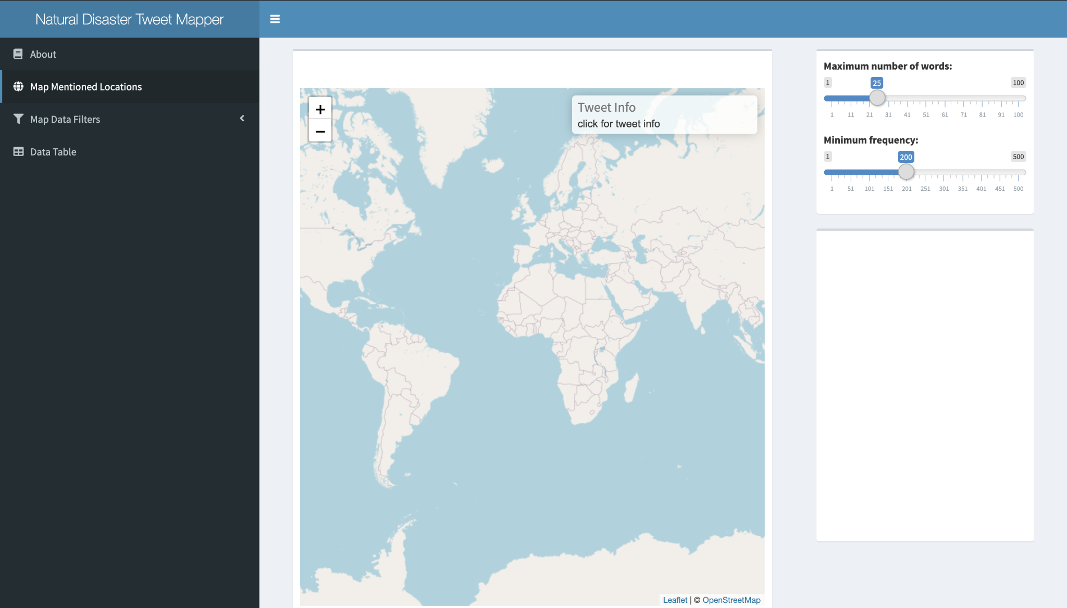
Shiny App Walkthrough - Map
Notes:
DO NOT PUT ANY INSTRUCTOR NOTES HERE. ALL INSTRUCTOR NOTES SHOULD BE IN THE LESSON PLAN.

Slide 7
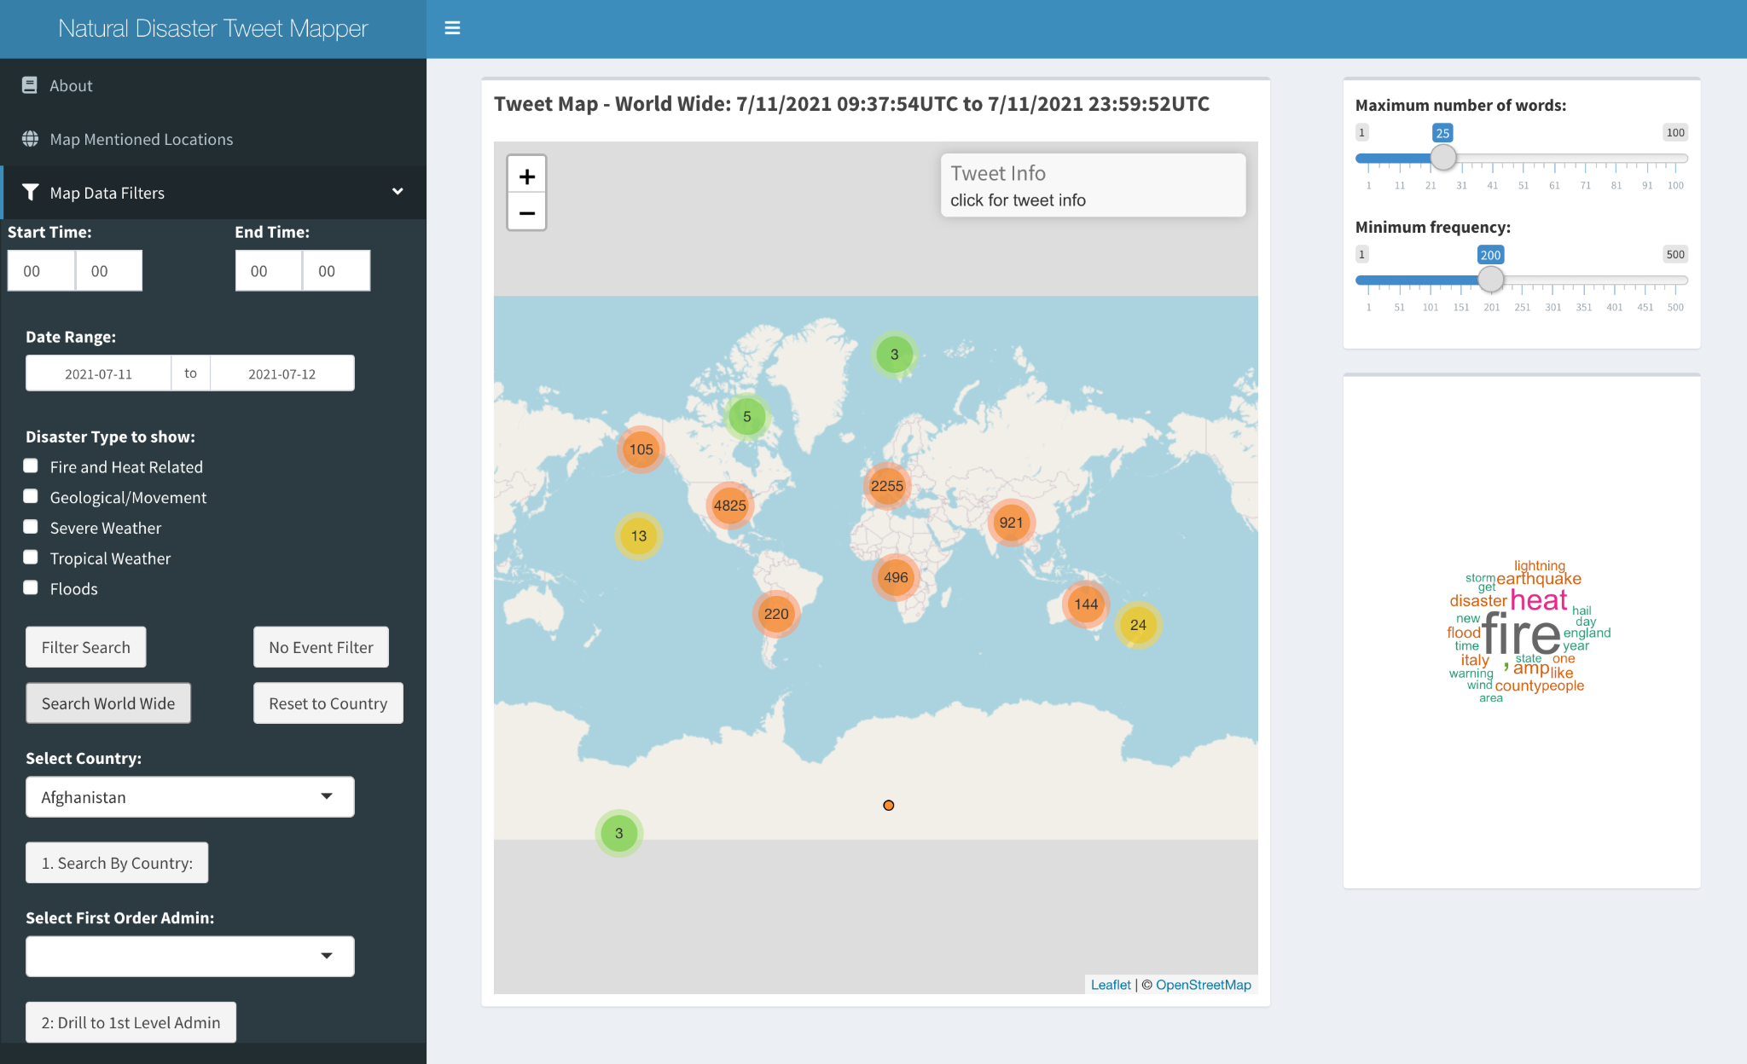
Shiny App Walkthrough - Clustering at Global Scale
Notes:
DO NOT PUT ANY INSTRUCTOR NOTES HERE. ALL INSTRUCTOR NOTES SHOULD BE IN THE LESSON PLAN.

Slide 8
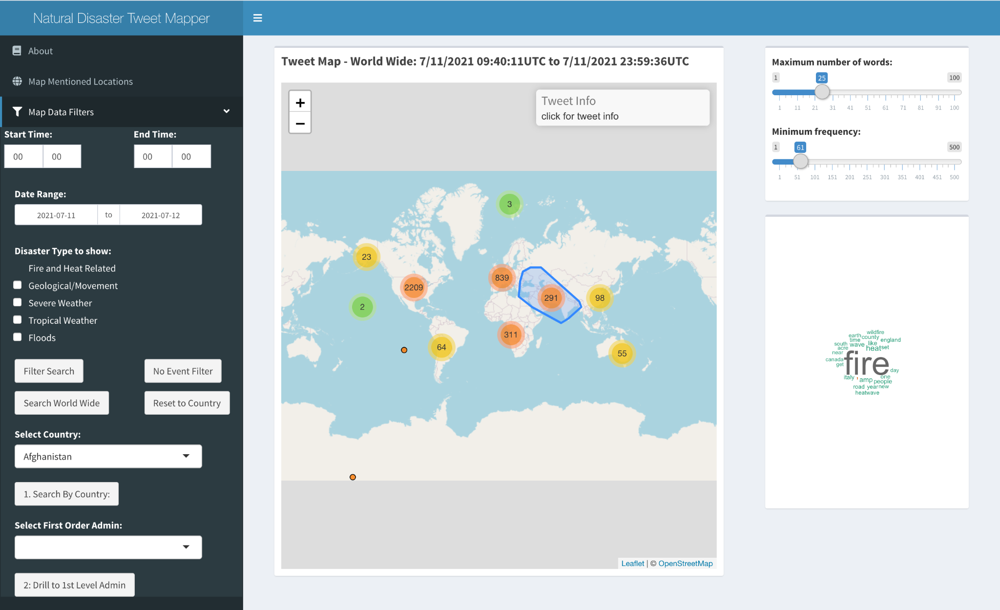
Shiny App Walkthrough - Group Filter
Notes:
DO NOT PUT ANY INSTRUCTOR NOTES HERE. ALL INSTRUCTOR NOTES SHOULD BE IN THE LESSON PLAN.

Slide 9
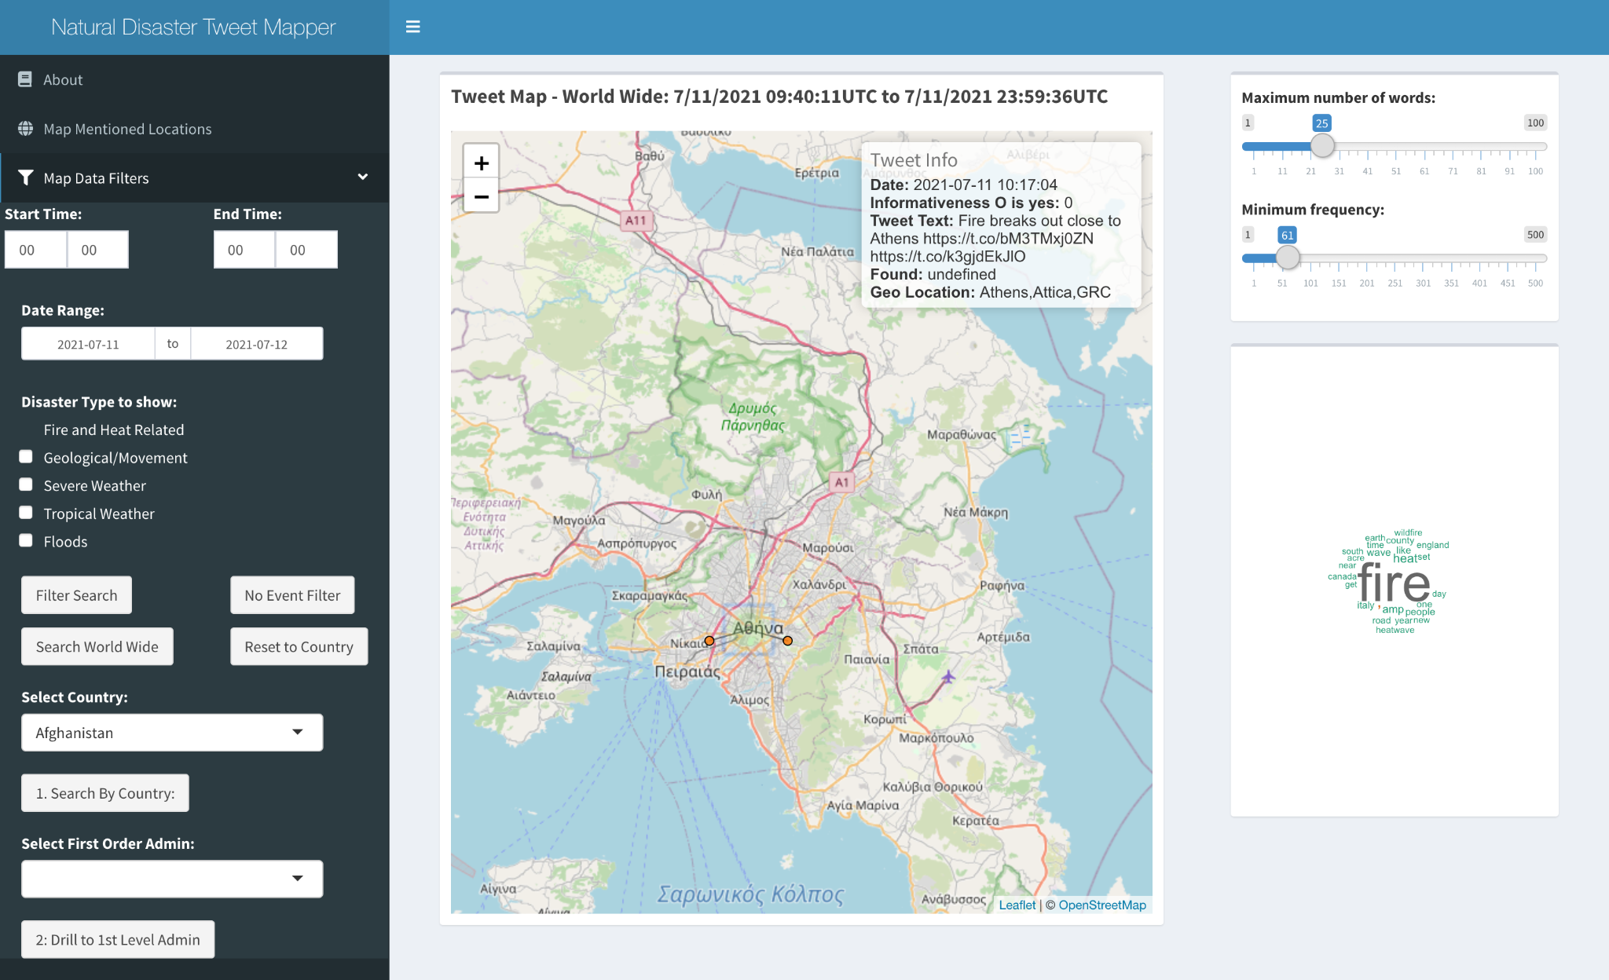
Shiny App Walkthrough - Zoom to Event
Notes:
DO NOT PUT ANY INSTRUCTOR NOTES HERE. ALL INSTRUCTOR NOTES SHOULD BE IN THE LESSON PLAN.

Slide 10
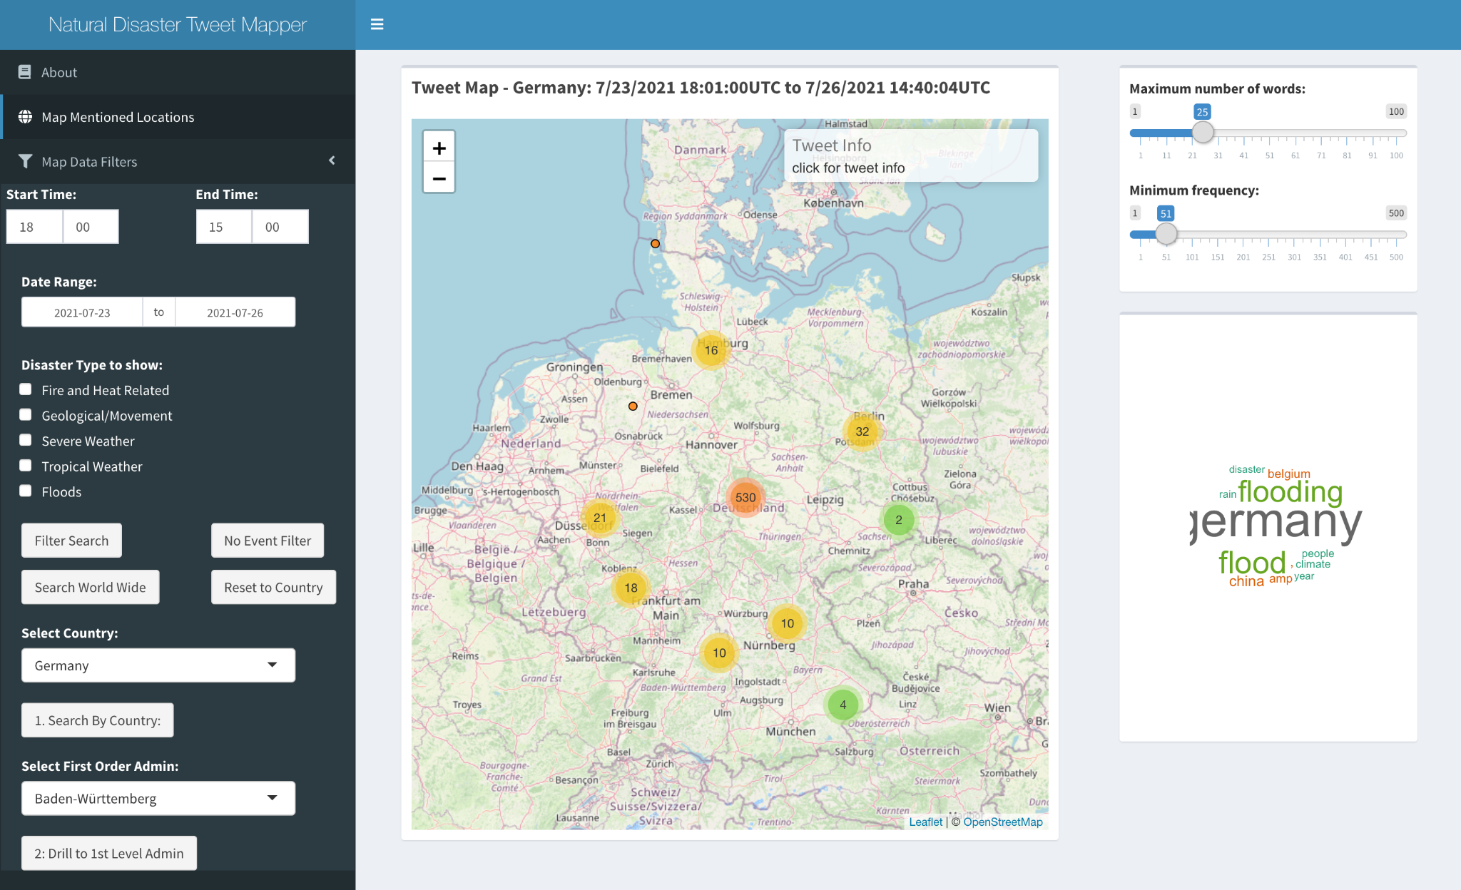
Shiny App Walkthrough - Country Scale
Notes:
DO NOT PUT ANY INSTRUCTOR NOTES HERE. ALL INSTRUCTOR NOTES SHOULD BE IN THE LESSON PLAN.

Slide 11
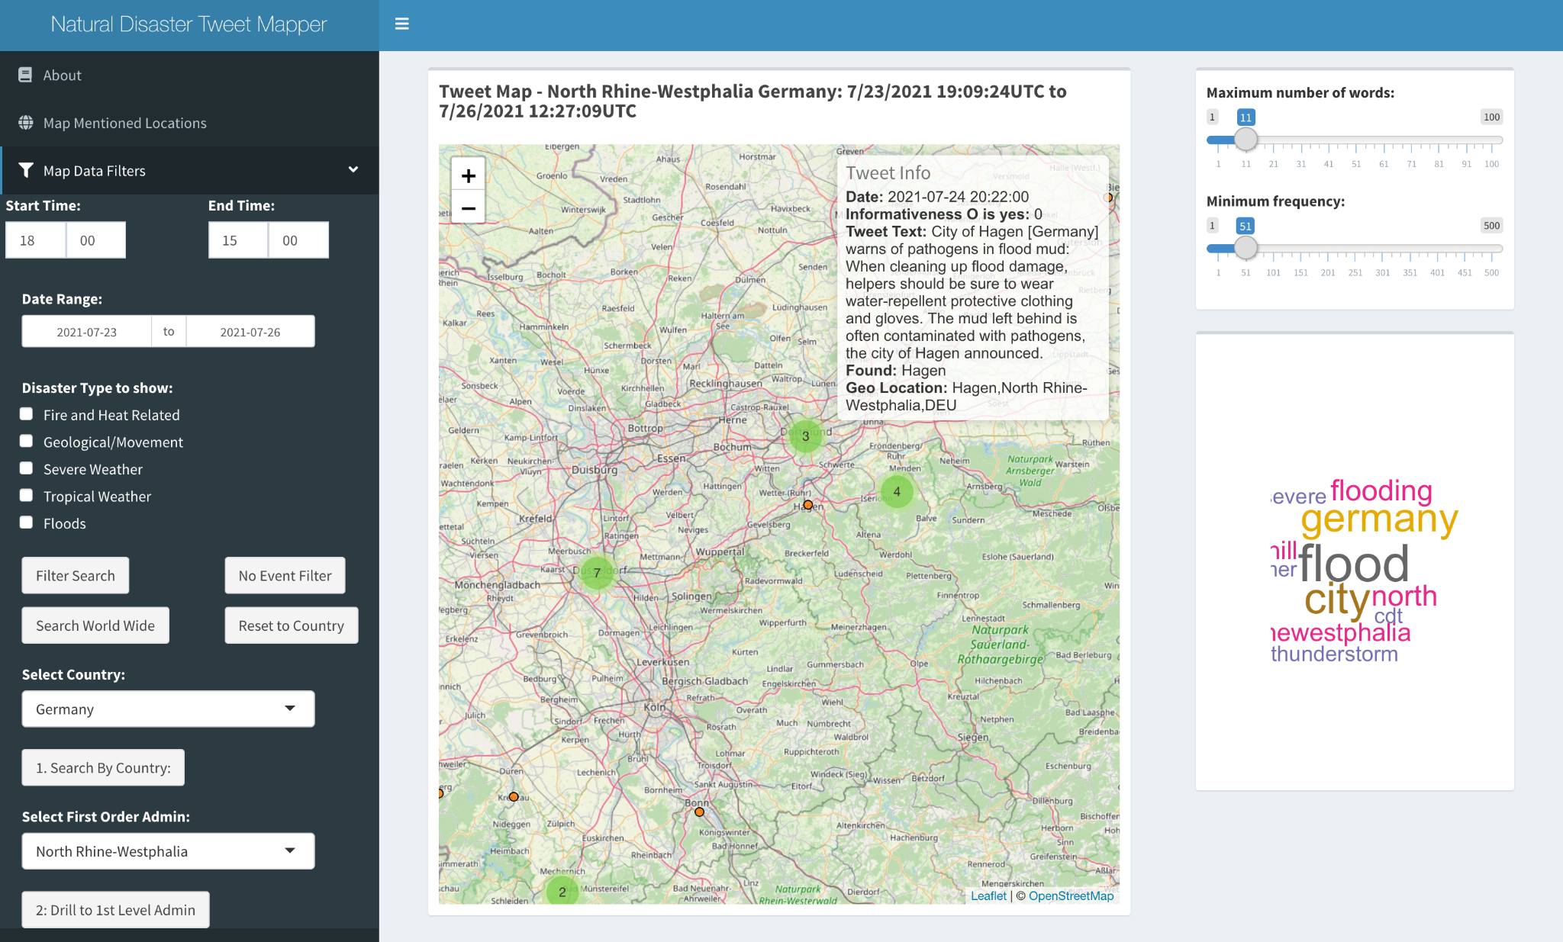
Shiny App Walkthrough - State/Province Drill Down
Notes:
DO NOT PUT ANY INSTRUCTOR NOTES HERE. ALL INSTRUCTOR NOTES SHOULD BE IN THE LESSON PLAN.

Slide 12
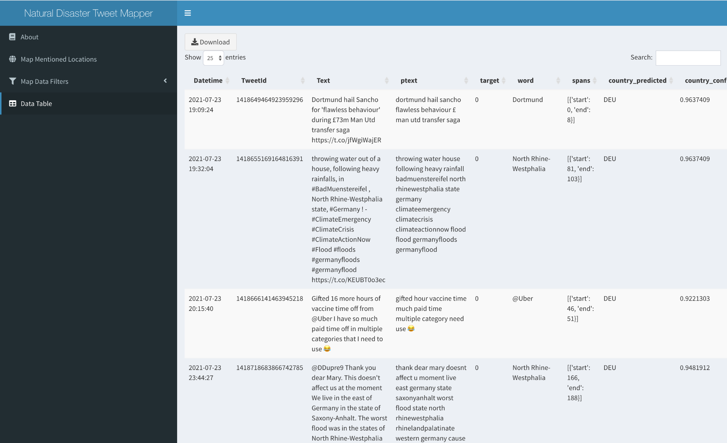
Shiny App Walkthrough - Data Table
Notes:
DO NOT PUT ANY INSTRUCTOR NOTES HERE. ALL INSTRUCTOR NOTES SHOULD BE IN THE LESSON PLAN.

Slide 13
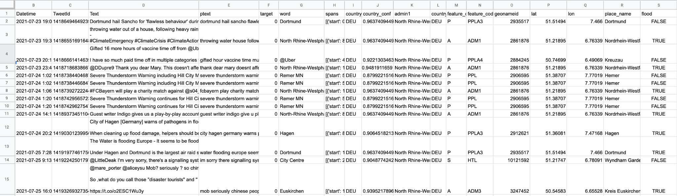
Shiny App Walkthrough - Download Results
Notes:
DO NOT PUT ANY INSTRUCTOR NOTES HERE. ALL INSTRUCTOR NOTES SHOULD BE IN THE LESSON PLAN.

Slide 14
Data Flow
Scrape Tweets from Web:
SNSCRAPE module
Pull tweets with interaction
English language
Condition and tokenize tweet text
stop words
use same method/data as training data
vectorize text
Predict Relevance
Use trained recurrent neural network model
binary classification
Geoparse
Mordecai module
Notes:
DO NOT PUT ANY INSTRUCTOR NOTES HERE. ALL INSTRUCTOR NOTES SHOULD BE IN THE LESSON PLAN.

Slide 15
Data Flow
Twitter
Predictions csv file
SNSCRAPE
API Call
No
Is Tweet Informative?
Has Location?
Text
Preprocessing
Yes
Yes
Append
Deduplication
text cleaning
extract countries,
join with cc,
1st order admins,
location names
Countries, 1st level admin and CC csv file
Daily Geos csv file
Country Names and Code csv file
Combined Geo-tweets csv file
Web App
Notes:
DO NOT PUT ANY INSTRUCTOR NOTES HERE. ALL INSTRUCTOR NOTES SHOULD BE IN THE LESSON PLAN.

Slide 16
Recurrent Neural Network Classification Model
Finding Training Data
Crisis NLP Project Qatar Computing Research Institute
Crisis Benchmark Data
Split into train & test sets
Text Processing
Clean, Tokenize, Remove Stopwords
Vectorize words - leverage GloVe: Global Vectors for Word Representation
TensorFlow and Keras
Build deep neural network
Hyperparameter Tuning - Hyperband vs Grid search
Final Model Build
K-folds cross validation
Notes:
DO NOT PUT ANY INSTRUCTOR NOTES HERE. ALL INSTRUCTOR NOTES SHOULD BE IN THE LESSON PLAN.

Slide 17
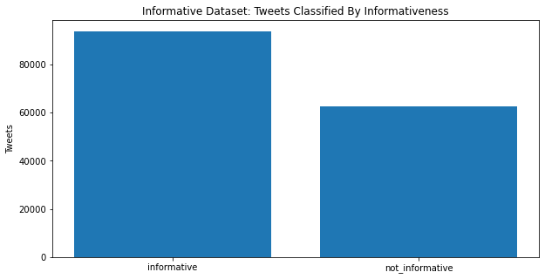
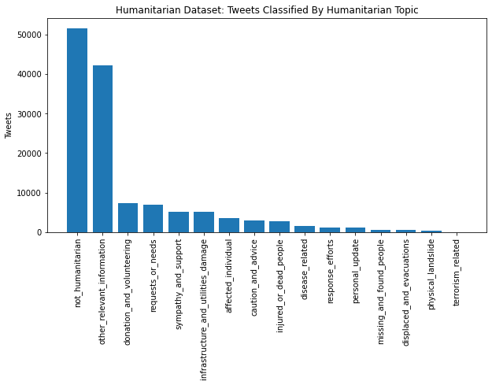
Training Data - Human Annotated Classes
Classification Schemas in two Datasets
156,000 tweets in Informativeness
130,000 tweets in Humanitarian Topic

Slide 18
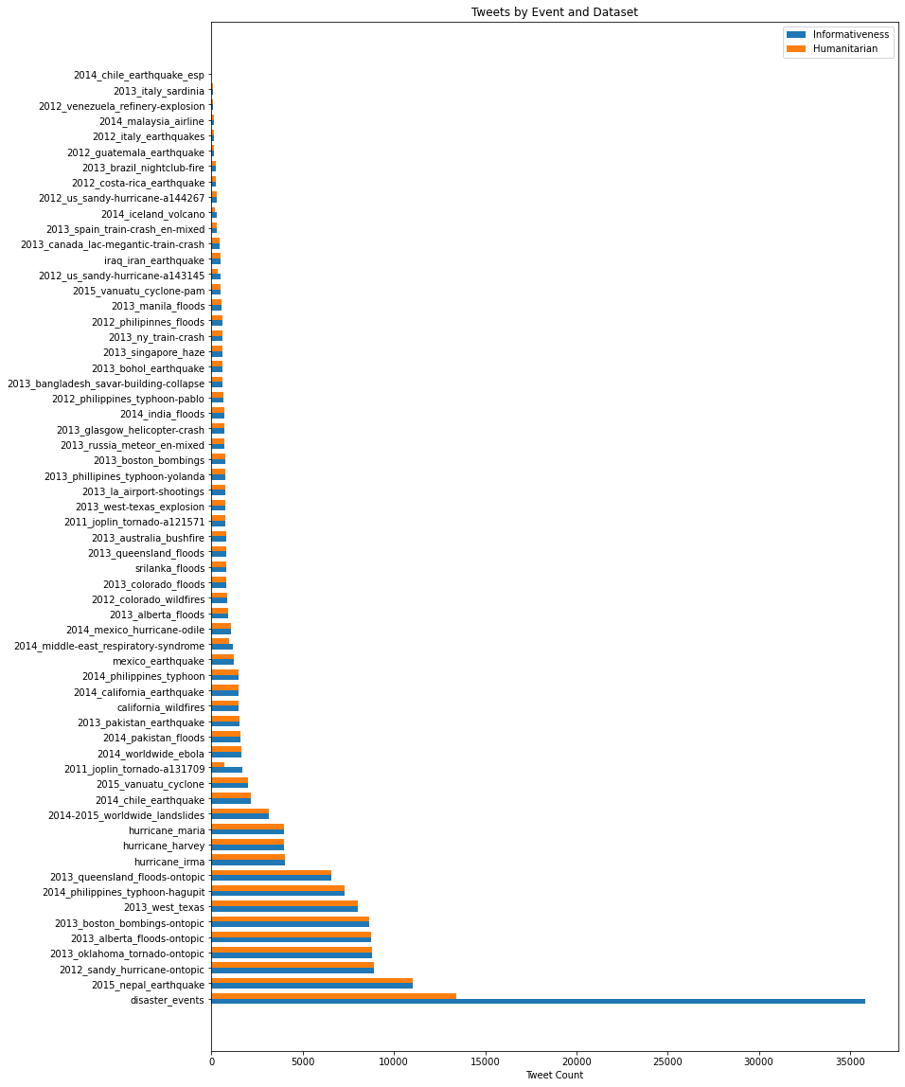
Training Data - Tweets per Event
61 disaster events from 2011 to 2017.

Slide 19
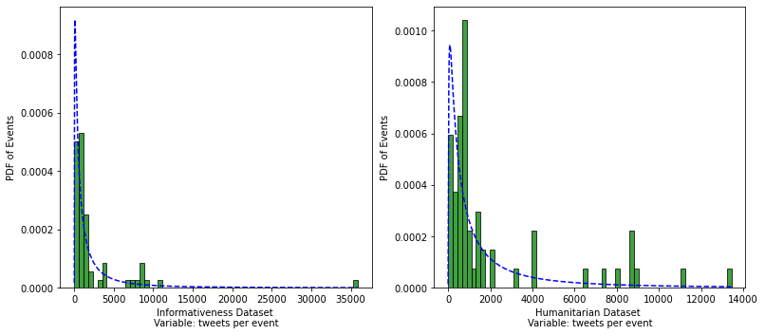
Training Data - Tweets per Event
Most of the events consist of fewer than 5,000 tweets.

Slide 20
Model Development - Text Conditioning
def clean_text(text):
'''Make text lowercase, remove links,remove punctuation
and remove words containing numerals.'''
text = text.lower()
#get rid of usernames
tweet_words = text.strip('\r').split(' ')
for word in [word for word in tweet_words if '@' in word]:
text = text.replace(word, "")
#get rid of the re-tweet
tweet_words = text.strip('\r').split(' ')
for word in [word for word in tweet_words if 'rt' == word]:
text = text.replace(word, "")
text = re.sub('https?://\S+|www\.\S+', '', text)
text = re.sub('[%s]' % re.escape(punctuation), '', text)
text = re.sub('\n', '', text)
text = re.sub('\w*\d\w*', '', text)
return text
# Applying the cleaning function to both test and train datasets
train_data['text'] = train_data['text'].apply(lambda x: clean_text(x))
test_data['text'] = test_data['text'].apply(lambda x: clean_text(x))
Convert text to lower case
Remove mentions and usernames
Remove the “rt” for retweets
clean out links
Clean text for punctuation
return each tweet text as list of words
In the prediction workflow, saved as “ptext” variable to retain the original tweet text

Slide 21
Model Development - Text Conditioning
train_data['text'] = train_data['text'].apply(lambda x:word_tokenize(x))
test_data['text'] = test_data['text'].apply(lambda x:word_tokenize(x))
def remove_stopwords(text):
words = [w for w in text if w not in stopwords.words('english')]
return words
train_data['text'] = train_data['text'].apply(lambda x : remove_stopwords(x))
test_data['text'] = test_data['text'].apply(lambda x : remove_stopwords(x))
def lemmatize_text(text):
lemmatizer = WordNetLemmatizer()
return [lemmatizer.lemmatize(w) for w in text] ##Notice the use of text.
train_data['text'] = train_data['text'].apply(lambda x : lemmatize_text(x))
test_data['text'] = test_data['text'].apply(lambda x : lemmatize_text(x))
def concatenate_text(text):
return ' '.join(text)
train_data['text'] = train_data['text'].apply(lambda x : concatenate_text(x))
test_data['text'] = test_data['text'].apply(lambda x : concatenate_text(x))
Tokenize,
Remove stop words,
Lemmatize,
Convert back to string

Slide 22
Text Vectorization and Building Vocabulary
Two Initial Approaches and Shortcomings
TF-IDF: Term frequency inverse document frequency
Weighs occurence of terms in a document vs prevalence in all documents
Limited Character in tweets
Sparse vs Verbose matrix issues
Built in TensorFlow Text vectorizer
Required data in specific file structure
Model overfitting

Slide 23
Text Vectorization and Building Vocabulary
Solution and Implementation for Model
GloVe: Global Vectors for Word Representation
Word embedding specifically built from 2 billion tweets
200 dimension vector with 27 billion tokens and vocab of 1.2 million
Build embedding matrix and vectorizer compatible with tensorflow

Slide 24
Embeddings Index - Built from GloVe
path_to_glove_file = '/content/drive/MyDrive/Capstone/WordVector/WordVector/glove.twitter.27B.200d.txt'
embeddings_index = {}
f = open(path_to_glove_file, 'r', encoding='utf8')
for line in f:
splitLine = line.split(' ')
word = splitLine[0] # the first entry is the word
coefs = np.asarray(splitLine[1:], dtype='float32') # these are the vectors representing word embeddings
embeddings_index[word] = coefs
print("Glove data loaded! In total:",len(embeddings_index)," words.")

Slide 25
Embeddings Matrix and Vectorizer
def make_embedding_matrix(train_samples, val_samples, embeddings_index):
vectorizer = TextVectorization(max_tokens=55000, output_sequence_length=50)
text_ds = tf.data.Dataset.from_tensor_slices(train_samples).batch(128)
vectorizer.adapt(text_ds)
voc = vectorizer.get_vocabulary()
word_index = dict(zip(voc, range(len(voc))))
num_tokens = len(voc)
hits = 0
misses = 0
# creating an embedding matrix
embedding_dim = len(embeddings_index['the'])
embedding_matrix = np.zeros((num_tokens, embedding_dim))
for word, i in word_index.items():
embedding_vector = embeddings_index.get(word)
if embedding_vector is not None:
# Words not found in embedding index will be all-zeros
embedding_matrix[i] = embedding_vector
hits += 1
else:
misses += 1
# print("Converted %d words (%d misses)" % (hits, misses))
print(f"Converted {hits} words ({misses} misses).")
return embedding_matrix, vectorizer

Slide 26
Building Model and Training Hyperparameters - Round 1
def myparamalam(hp):
"""
This function initializes Keras model for binary text classification
Parameters:
embedding matrix with the dimensions (num_tokens, embedding_dim),
where num_tokens is the vocabulary size of the input data,
and emdebbing_dim is the number of components in the GloVe vectors
Returns:
model: Keras model
"""
hp_num_nodes = hp.Choice('num_units', values =[16,32,64,128])
hp_activation = hp.Choice('activator',values=['tanh','sigmoid', 'relu'])
hp_activation2 = hp.Choice('activator2',values=['tanh','sigmoid', 'relu'])
HP_DROPOUT_IN = hp.Choice('dropout_in_rate', values=[0.7, 0.8, 0.9])
HP_DROPOUT = hp.Choice('dropout_rate', values=[0.4, 0.5, 0.6])
hp_learning_rate = hp.Choice('learning_rate', values=[1e-2,1e-3,1e-4])
num_tokens = embedding_matrix.shape[0]
embedding_dim = embedding_matrix.shape[1]
embedding_layer = Embedding(
num_tokens,
embedding_dim,
embeddings_initializer=keras.initializers.Constant(embedding_matrix),
trainable=False, # we are not going to train the embedding vectors
)

Slide 27
Building Model and Training Hyperparameters
# Here we define the architecture of the Keras model.
int_sequences_input = keras.Input(shape=(None,), dtype="int64")
x = embedding_layer(int_sequences_input)
x = layers.Dropout(HP_DROPOUT_IN)(x)
x = layers.Bidirectional(layers.LSTM(hp_num_nodes,
dropout=HP_DROPOUT,
return_sequences=True))(x)
x = layers.Bidirectional(layers.LSTM(hp_num_nodes,
dropout=HP_DROPOUT))(x)
x = layers.Dense(hp_num_nodes,activation= hp_activation)(x)
x = layers.Dropout(HP_DROPOUT)(x)
preds = layers.Dense(1, activation=hp_activation2)(x)
model = keras.Model(int_sequences_input, preds)
# print('')
# print("Training the model...")
model.compile(optimizer=tf.keras.optimizers.Adam(learning_rate=hp_learning_rate),
loss=tf.keras.losses.BinaryCrossentropy(from_logits=True),
metrics=['accuracy','binary_accuracy',])
return model

Slide 28
Building Model and Training Hyperparameters
LOG_DIR3 = "/content/drive/MyDrive/Capstone/loggy2"
x_train = vectorizer(np.array([[s] for s in train_samples])).numpy()
x_val = vectorizer(np.array([[s] for s in val_samples])).numpy()
y_train = np.asarray(train_labels).astype('float32').reshape((-1,1))
y_val = np.asarray(val_labels).astype('float32').reshape((-1,1))
tuner = Hyperband(
myparamalam,
objective='val_binary_accuracy',
max_epochs= 1000, # how many model variations to test?
directory=LOG_DIR3)
tuner.search_space_summary(extended=False)
tuner.search(x_train, y_train,
verbose=1,
batch_size=64,
callbacks=[tf.keras.callbacks.EarlyStopping(monitor='val_loss', patience=3)],
validation_data=(x_val, y_val))

Slide 29
Selecting Hyperparameters
Trade off of Time vs. Exhaustiveness
Number of distinct models to test Increases geometrically
could take several days to test every instance
Hyperband Algorithm Tests configurations iteratively, drops low performers
Investigate which Hyperparameter contribute most to accuracy/loss
HiPlot Module - allows real time investigation of which hyperparameter values consistently lead to high accuracy and low loss
Values for Round 2 of Tuning
Dropout to 0.7, final activation to ‘sigmoid’, and learning rate to 0.001

Slide 30
Building Model and Training Hyperparameters
def myparamalam2(hp):
hp_num_nodes = hp.Choice('num_units', values =[16,32,64,128])
hp_num_nodes2 = hp.Choice('num_units2', values =[16,32,64,128])
hp_num_nodes3 = hp.Choice('num_units3', values =[16,32,64,128])
hp_activation = hp.Choice('activator',values=['tanh','sigmoid', 'relu'])
HP_DROPOUT = hp.Choice('dropout_rate', values=[0.4, 0.5])
HP_DROPOUT2 = hp.Choice('dropout_rate2', values=[0.4, 0.5])
HP_DROPOUT3 = hp.Choice('dropout_rate3', values=[0.4, 0.5])
num_tokens = embedding_matrix.shape[0]
embedding_dim = embedding_matrix.shape[1]
embedding_layer = Embedding(
num_tokens,
embedding_dim,
embeddings_initializer=keras.initializers.Constant(embedding_matrix),
trainable=False, # we are not going to train the embedding vectors
)

Slide 31
Building Model and Training Hyperparameters
# Here we define the architecture of the Keras model.
int_sequences_input = keras.Input(shape=(None,), dtype="int64")
x = embedding_layer(int_sequences_input)
x = layers.Dropout(.7)(x)
x = layers.Bidirectional(layers.LSTM(hp_num_nodes,
dropout=HP_DROPOUT,
return_sequences=True))(x)
x = layers.Bidirectional(layers.LSTM(hp_num_nodes2,
dropout=HP_DROPOUT2))(x)
x = layers.Dense(hp_num_nodes3,activation= hp_activation)(x)
x = layers.Dropout(HP_DROPOUT3)(x)
preds = layers.Dense(1, activation='sigmoid')(x)
model = keras.Model(int_sequences_input, preds)
model.compile(optimizer=tf.keras.optimizers.Adam(learning_rate=1e-3),
loss=tf.keras.losses.BinaryCrossentropy(from_logits=True),
metrics=['accuracy','binary_accuracy',])
return model

Slide 32
Building Model and Training Hyperparameters
LOG_DIR3 = "/content/drive/MyDrive/Capstone/loggy3"
x_train = vectorizer(np.array([[s] for s in train_samples])).numpy()
x_val = vectorizer(np.array([[s] for s in val_samples])).numpy()
y_train = np.asarray(train_labels).astype('float32').reshape((-1,1))
y_val = np.asarray(val_labels).astype('float32').reshape((-1,1))
tuner = Hyperband(
myparamalam2,
objective='val_binary_accuracy',
max_epochs= 1000, # how many model variations to test?
directory=LOG_DIR3)
tuner.search_space_summary(extended=False)
tuner.search(x_train, y_train,
verbose=1,
batch_size=64,
callbacks=[tf.keras.callbacks.EarlyStopping(monitor='val_loss', patience=3)],
validation_data=(x_val, y_val))

Slide 33
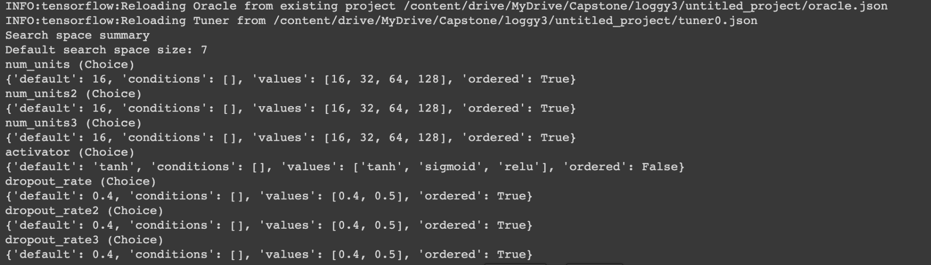
Building Model and Training Hyperparameters

Slide 34
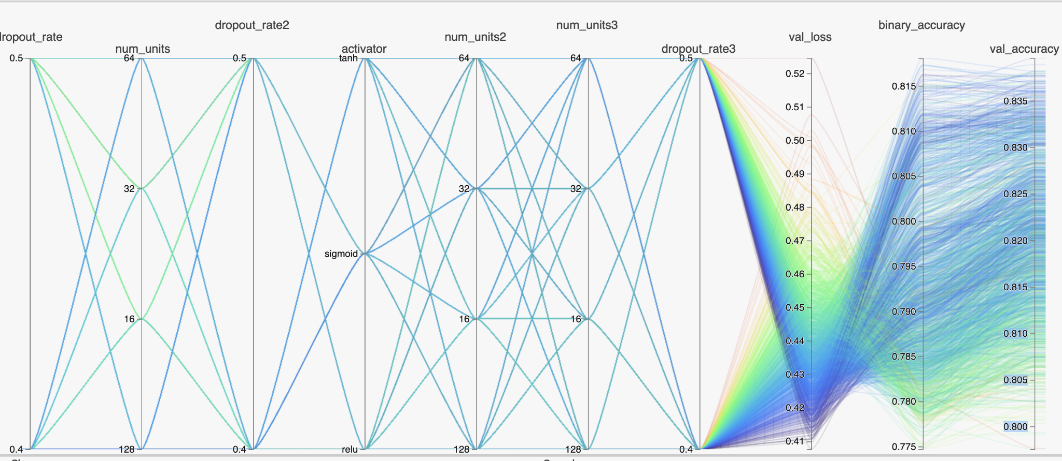
Final Hyperparameter Selection

Slide 35
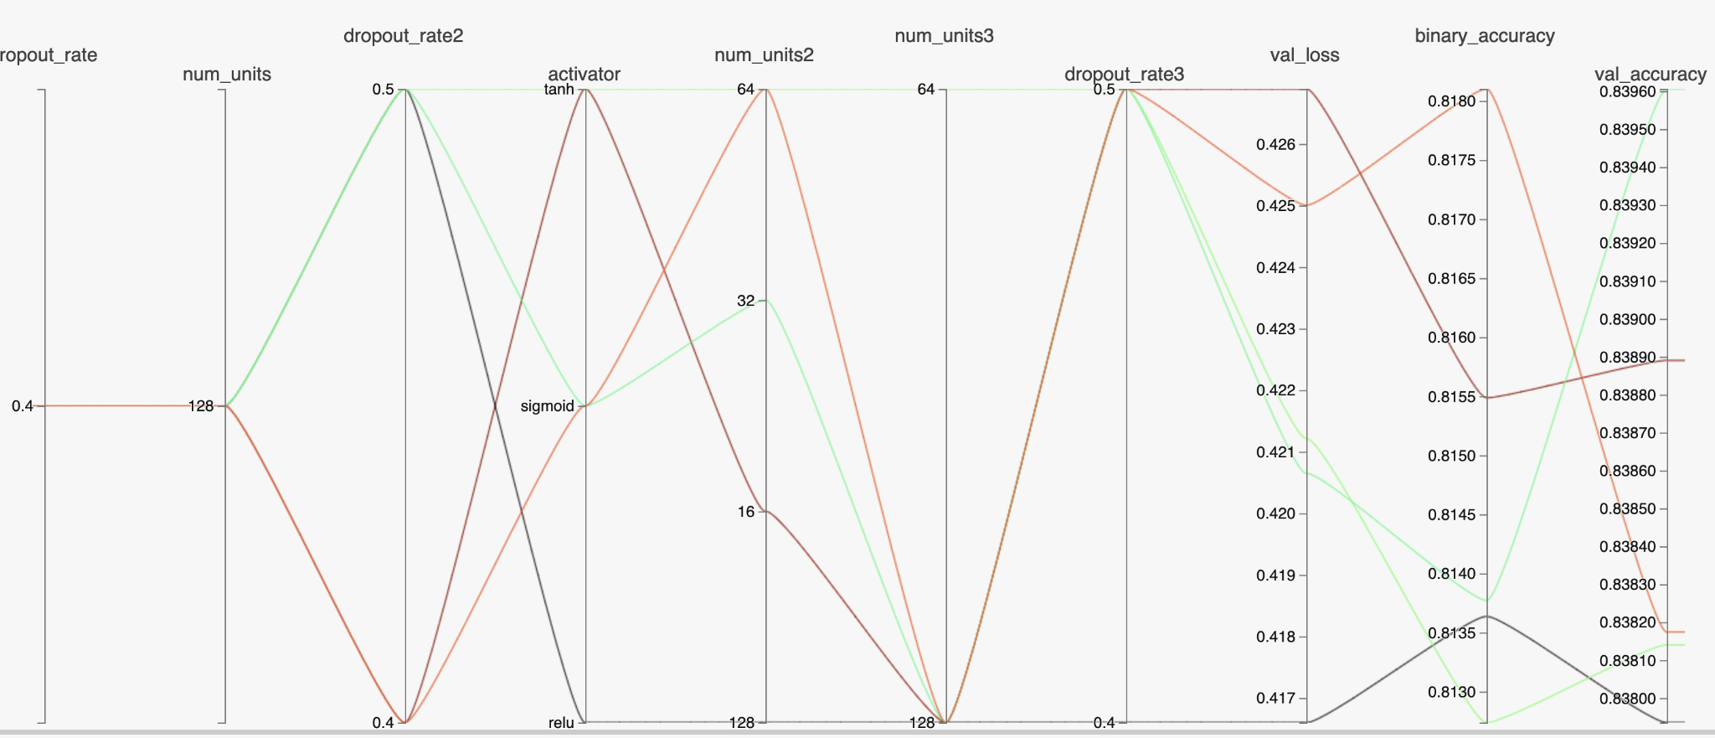
Final Hyperparameter Selection

Slide 36
Final Model Training
from sklearn.model_selection import KFold
import numpy as np
num_folds = 5
acc_list = []
acc_per_fold = []
loss_list = []
loss_per_fold = []
inputs = np.concatenate((x_train,x_val, x_test), axis=0)
targets = np.concatenate((y_train,y_val, y_test), axis=0)
kfold = KFold(n_splits=num_folds, shuffle=True)
fold_no = 1
for train, test in kfold.split(inputs, targets):
num_tokens = embedding_matrix.shape[0]
embedding_dim = embedding_matrix.shape[1]
embedding_layer = Embedding(
num_tokens,
embedding_dim,
embeddings_initializer=keras.initializers.Constant(embedding_matrix),
trainable=False, # we are not going to train the embedding vectors
)

Slide 37
Final Model Training
# Here we define the architecture of the Keras model.
int_sequences_input = keras.Input(shape=(None,), dtype="int64")
x = embedding_layer(int_sequences_input)
x = layers.Dropout(.7)(x)
x = layers.Bidirectional(layers.LSTM(128,
dropout=.4,
return_sequences=True))(x)
x = layers.Bidirectional(layers.LSTM(32,
dropout=.5))(x)
x = layers.Dense(128,activation= 'sigmoid')(x)
x = layers.Dropout(.5)(x)
preds = layers.Dense(1, activation='sigmoid')(x)
model = keras.Model(int_sequences_input, preds)
model.compile(optimizer=tf.keras.optimizers.Adam(learning_rate=1e-3),
loss=tf.keras.losses.BinaryCrossentropy(),
metrics=['binary_accuracy',])
# Generate a print
print('------------------------------------------------------------------------')
print(f'Training for fold {fold_no} ...')

Slide 38
Final Model Training
# Fit data to model
history = model.fit(inputs[train], targets[train],
batch_size=128,
epochs=120,
callbacks=[tf.keras.callbacks.EarlyStopping(monitor='loss', patience=3,
restore_best_weights = True,
verbose = 1, min_delta = .0002 ),
tf.keras.callbacks.ModelCheckpoint(filepath=cppath,
save_weights_only=True,
verbose=1)
],
verbose=1)
acc = history.history['binary_accuracy']
loss = history.history['loss']
acc_list.append(acc)
loss_list.append(loss)
# Generate generalization metrics
scores = model.evaluate(inputs[test], targets[test], verbose=0)
print(f'Score for fold {fold_no}: {model.metrics_names[0]} of {scores[0]}; {model.metrics_names[1]} of {scores[1]*100}%')
acc_per_fold.append(scores[1] * 100)
loss_per_fold.append(scores[0])

Slide 39
Final Model Training
# Increase fold number
fold_no = fold_no + 1
# == Provide average scores ==
print('------------------------------------------------------------------------')
print('Score per fold')
for i in range(0, len(acc_per_fold)):
print('------------------------------------------------------------------------')
print(f'> Fold {i+1} - Loss: {loss_per_fold[i]} - Accuracy: {acc_per_fold[i]}%')
print('------------------------------------------------------------------------')
print('Average scores for all folds:')
print(f'> Accuracy: {np.mean(acc_per_fold)} (+- {np.std(acc_per_fold)})')
print(f'> Loss: {np.mean(loss_per_fold)}')
print('------------------------------------------------------------------------')

Slide 40
Final Model Parameters
Model: "model_18"
_________________________________________________________________
Layer (type) Output Shape Param #
=================================================================
input_19 (InputLayer) [(None, None)] 0
_________________________________________________________________
embedding_18 (Embedding) (None, None, 200) 11000000
_________________________________________________________________
dropout_36 (Dropout) (None, None, 200) 0
_________________________________________________________________
bidirectional_36 (Bidirectio (None, None, 256) 336896
_________________________________________________________________
bidirectional_37 (Bidirectio (None, 64) 73984
_________________________________________________________________
dense_36 (Dense) (None, 128) 8320
_________________________________________________________________
dropout_37 (Dropout) (None, 128) 0
_________________________________________________________________
dense_37 (Dense) (None, 1) 129
=================================================================
Total params: 11,419,329
Trainable params: 419,329
Non-trainable params: 11,000,000

Slide 41
5-Folds Cross Validation
Score per fold
------------------------------------------------------------------------
> Fold 1 - Loss: 0.3687956929206848 - Accuracy: 84.32456851005554%
------------------------------------------------------------------------
> Fold 2 - Loss: 0.3730575144290924 - Accuracy: 84.00818109512329%
------------------------------------------------------------------------
> Fold 3 - Loss: 0.376613974571228 - Accuracy: 84.14828777313232%
------------------------------------------------------------------------
> Fold 4 - Loss: 0.3698555827140808 - Accuracy: 83.95653367042542%
------------------------------------------------------------------------
> Fold 5 - Loss: 0.3686904311180115 - Accuracy: 83.98849368095398%
------------------------------------------------------------------------
Average scores for all folds:
> Accuracy: 84.08521294593811 (+- 0.13646713751306805)
> Loss: 0.3714026391506195
------------------------------------------------------------------------

Slide 42
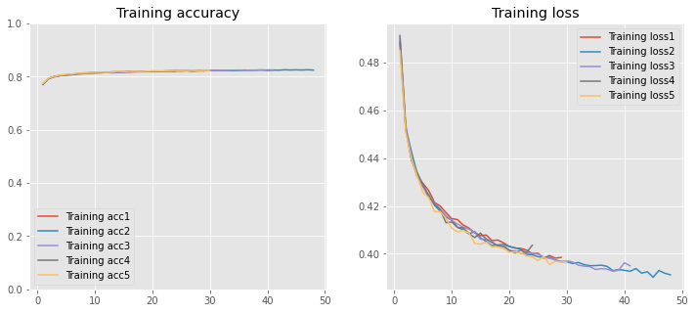
Accuracy of 5-Folds Cross Validation

Slide 43
Final Model in Production Workflow
def suggest_nn2(df, model):
"""
This function generates (binary) targets from a dataframe with column "text" using trained Keras model
Parameters:
df: pandas dataframe with column "text"
model: Keras model (trained)
Output:
predictions: list of suggested targets corresponding to string entries from the column "text"
"""
string_input = keras.Input(shape=(1,), dtype="string")
x = vectorizer(string_input)
preds = model(x)
end_to_end_model = keras.Model(string_input, preds)
probabilities = end_to_end_model.predict(df["Text"])
predictions = [1 if i > 0.5 else 0 for i in probabilities]
return predictions

Slide 44
Final Model in Production Workflow
predictions = suggest_nn2(pred_data, model)
submission_data = {"ID": pred_data['Tweet Id'].tolist(),"tweet": pred_data['Text'].tolist(), "target": predictions}
submission_df = pd.DataFrame(submission_data)
submission_df.to_csv('submission.csv', index=False)

Slide 45
Further Development
Improve Geotagging
Limited context in tweets
Customize gazetteer
Classification to multiple factors
16 Humanitarian factors in training data
Overcome likely overfitting due to small classes
Extend to news articles
More context for probably improves geotagging & classification
Article may cover multiple topics
Less “raw” - further from source in time and space
Load Results into SQL/RDBMS database for stability and enterprise solutions
Notes:
DO NOT PUT ANY INSTRUCTOR NOTES HERE. ALL INSTRUCTOR NOTES SHOULD BE IN THE LESSON PLAN.

Slide 46
Conclusion
Developed a Web application to map locations mentioned in natural disaster twitter posts.
Initiated a machine learning workflow to scrape twitter data, clean and process, classify for informativeness, and parse geolocations from text.
Trained a recurrent neural network with Tensorflow to classify unstructured social media posts for natural disaster informativeness.
Future research will focus on improving geolocation parsing, extending workflow to multiclass classification, utilizing other media sources, and integrating long term data storage and a spatial RDBMS into the workflow.

Slide 47
Notes:
DO NOT PUT ANY INSTRUCTOR NOTES HERE. ALL INSTRUCTOR NOTES SHOULD BE IN THE LESSON PLAN.

